Slide 1
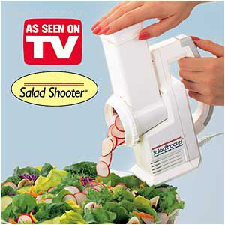
AREA SHOOTER?

Slide 2
AREA SHOOTER
AREA PLAN HELPER
BEYOND AEC HACKATHON 2018
Matt Mason, Programmer Extraordinaire
Imaginit
Chris Mungenast, Algorithms and Pseudo Code
Elkus Manfredi
Jess Purcell, VP of Breaking Stuff (QA)
Shepley Bulfinch
Thank you Sponsors and Volunteers!!

Slide 3
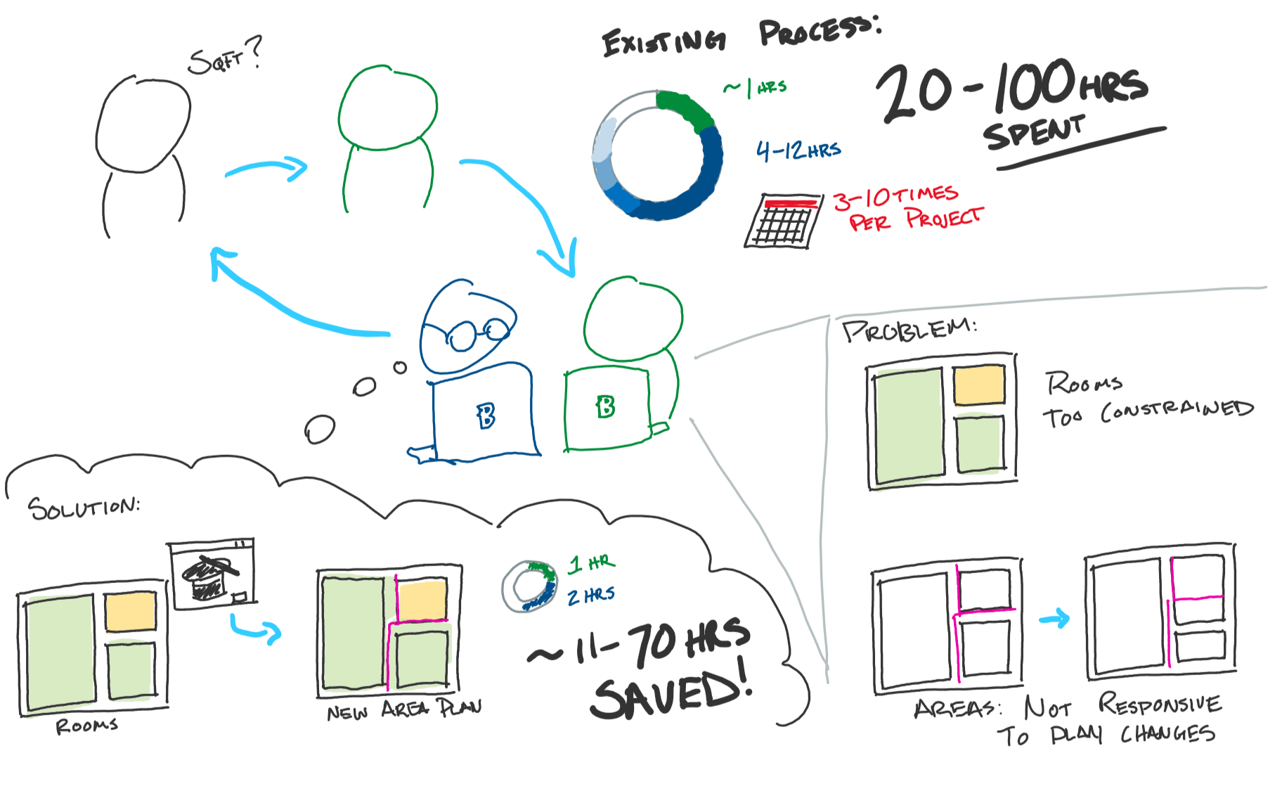
AREA PLAN HELPER
Problem statement:
Standard regulatory floor area calculations are very hard to do accurately, and quickly in Revit

Slide 4
AREA PLAN HELPER
Places an area separation line based on the weighted score of the adjacent rooms.

Slide 5
AREA PLAN HELPER

Slide 6
AREA PLAN HELPER
The Details:
User assigns values for BOMA-style categories into the Rooms.
Area separation lines placed at correct wall location based on categories.
Area plans are automatically created in seconds instead of hours.
Checks and clean-up algorithms tighten up Area bounding.
On subsequent iterations, may be easier to recreate area plan than update.
BOMA-style catgories are user-definable!

